Slide 1
Microservices

Slide 2
Monolithic Architecture
Single Code Base
Hard to understand and maintain.
Complex deployments and scheduled downtimes.
Written in single application language.
You need to scale the whole application.

Slide 3
What are Microservices?
Microservies is an architectural style
Large complex apps contain one or more services.
Does one task does it well.
Small and focused
Loosely Coupled
Language neutral
Bounded Context

Slide 4
SOA vs Microservices
In case of SOA different applications written in various languages intercommunicate. Often the mediation is done through the ESB.
In case of Microservices, we are redesigning a single application into distributed system of services.

Slide 5
12 Factor App
Code is Version Controlled
Dependencies are declared and isolated
Configuration is stored in the Environment
Treat backing services as attached resources
Strictly separate build and run stages
Execute the app as one or more stateless processes
Export services via port binding
Scale out via the process model
Maximum robustness with fast startup and graceful shutdown
Keep development, staging and production as similar as possible
Treat logs as event streams
Run admin tasks as one-off processes

Slide 6
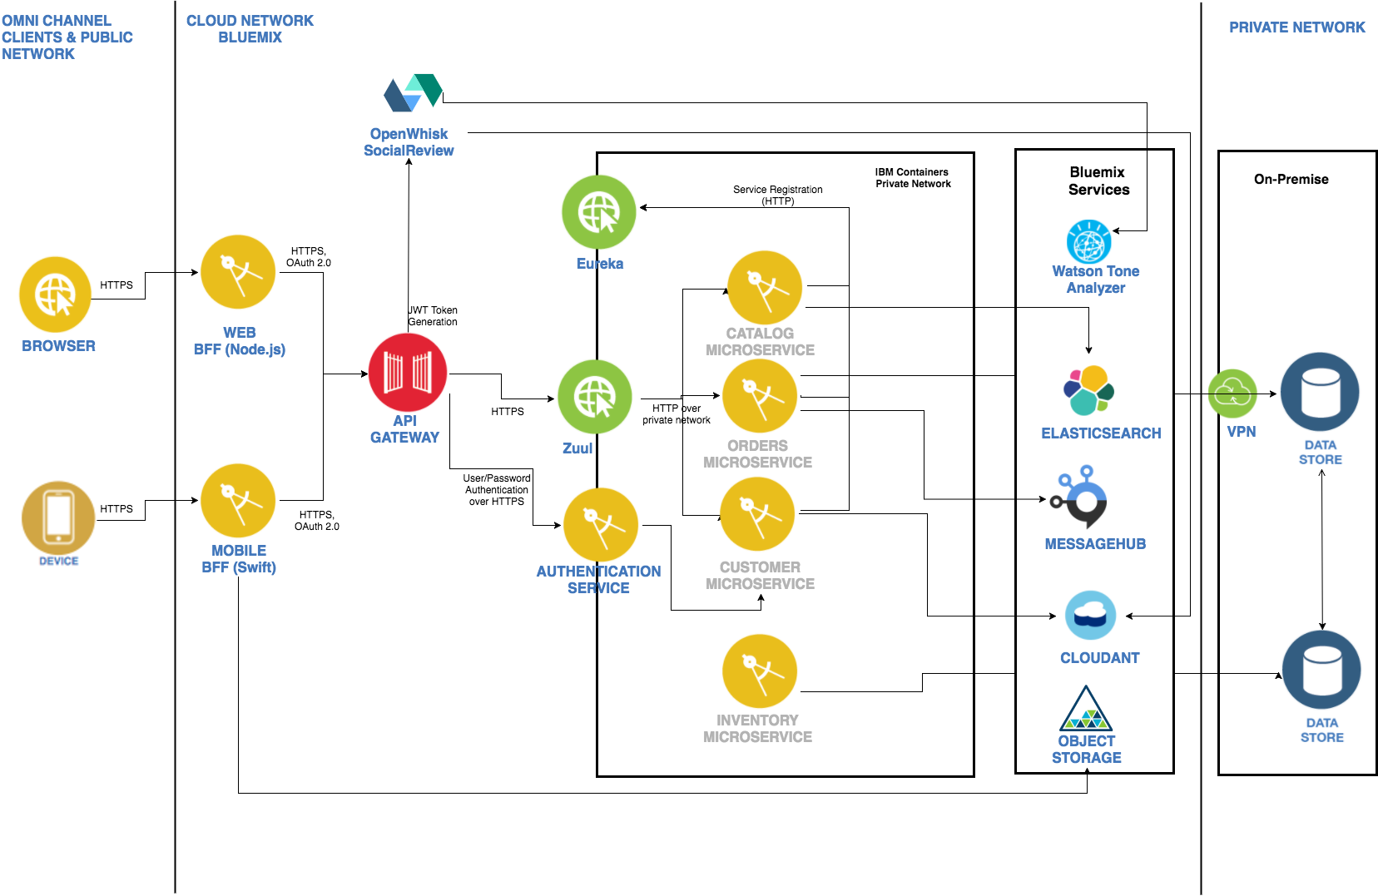
IBM Cloud Native Reference Architecture
https://github.com/ibm-cloud-architecture/refarch-cloudnative

Slide 7
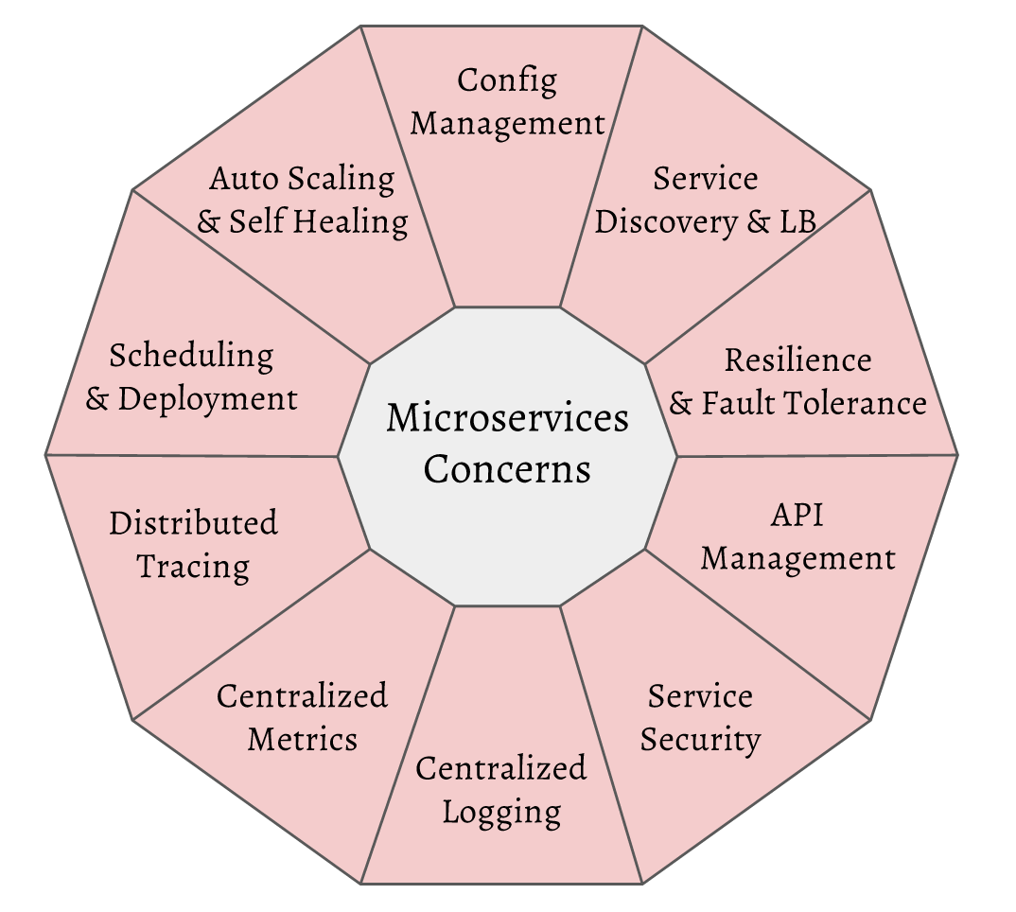
Microservices Concerns

Slide 8
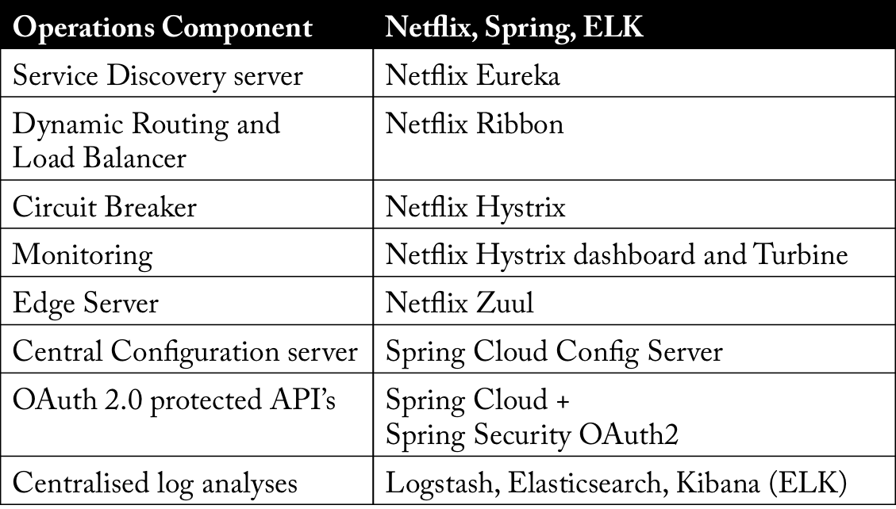

Slide 9
Hello World Spring Boot App
start.spring.io
Select web dependency
Import maven project in Eclipse
Add a Rest Controller
Add a Request Mapping
@RestController
@RequestMapping(value = "/controller")
public class HelloResource {
@GetMapping("/hello")
public String getMessage(){

Slide 10
Eureka Server
<dependency>
<groupId>org.springframework.cloud</groupId>
<artifactId>spring-cloud-starter-eureka-server</artifactId>
</dependency>
@SpringBootApplication
@EnableEurekaServer
public class TrngEurekaApplication {
bootstrap.yml >>
spring:
application:
name: trng-eureka-service

Slide 11
Eureka Server
application.yml >>
server:
port: 8761
eureka:
client:
registerWithEureka: false
fetchRegistry: false
server:
waitTimeInMsWhenSyncEmpty: 0
http://localhost:8080/

Slide 12
Admin Microservice
<dependency>
<groupId>org.springframework.cloud</groupId>
<artifactId>spring-cloud-starter-eureka</artifactId>
</dependency>
@SpringBootApplication
@EnableDiscoveryClient
public class TrngAdminApplication {
eureka:
client:
serviceUrl:
defaultZone: http://localhost:8761/eureka

Slide 13
Salary Microservice
<dependency>
<groupId>org.springframework.cloud</groupId>
<artifactId>spring-cloud-starter-eureka</artifactId>
</dependency>
@SpringBootApplication
@EnableDiscoveryClient
public class TrngSalaryApplication {
eureka:
client:
serviceUrl:
defaultZone: http://localhost:8761/eureka

Slide 14
Zuul Proxy (Gateway)
<dependency>
<groupId>org.springframework.cloud</groupId>
<artifactId>spring-cloud-starter-eureka</artifactId>
</dependency>
<dependency>
<groupId>org.springframework.cloud</groupId>
<artifactId>spring-cloud-starter-zuul</artifactId>
</dependency>
@SpringBootApplication
@EnableZuulProxy
@EnableDiscoveryClient
public class TrngZuulApplication {

Slide 15
Zuul Proxy (Gateway)
server:
port: 8080
eureka:
client:
serviceUrl:
defaultZone: http://localhost:8761/eureka
zuul:
routes:
admin-service:
path: /admin-service/**
serviceId: trng-admin-service
salary-service:
path: /salary-service/**
serviceId: trng-salary-service
http://localhost:8080/admin-service/admin/role?name=Goutham
http://localhost:8080/salary-service/payroll/salary?name=Goutham

Slide 16
Ribbon (Client side load balancing)
<dependency>
<groupId>org.springframework.cloud</groupId>
<artifactId>spring-cloud-starter-ribbon</artifactId>
</dependency>
@SpringBootApplication
@EnableDiscoveryClient
public class TrngRibbonClientApplication {
@RestController
@RequestMapping("/ribbon")
public class Resource {
@LoadBalanced
@Bean
public RestTemplate getRestTemplate(){
return new RestTemplate();
}
http://localhost:8813/ribbon/detail?name=Goutham

Slide 17
Ribbon (Client side load balancing)
Microservice A
Microservice B
Ribbon Client
Ribbon Client
Eureka
Eureka
Microservice B
Instance #1
Microservice B
Instance #2
Microservice A
Instance #1
Microservice A
Instance #2

Slide 18
Feign (Declarative REST client)
<dependency>
<groupId>org.springframework.cloud</groupId>
<artifactId>spring-cloud-starter-feign</artifactId>
</dependency>
@SpringBootApplication
@EnableDiscoveryClient
@EnableFeignClients
public class TrngFeignClientApplication {
@FeignClient("TRNG-ADMIN-SERVICE")
interface AdminClient {
@FeignClient("TRNG-SALARY-SERVICE")
interface SalaryClient {
http://localhost:8814/feign/detail?name=Goutham

Slide 19
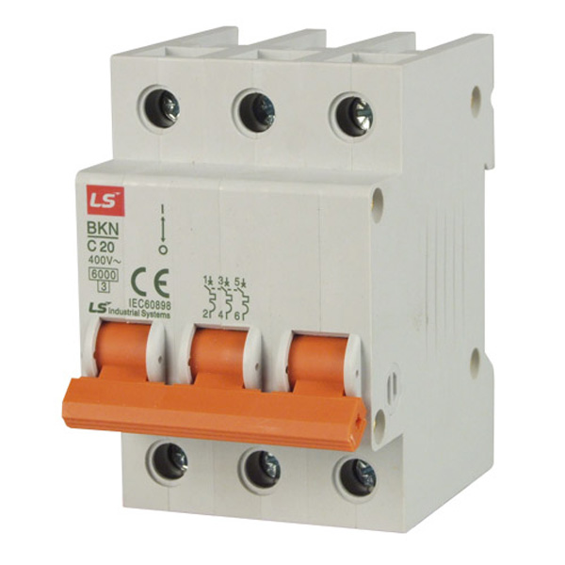
Circuit Breaker Pattern
Circuit Breaker is a design pattern used in software development
It is used to detect defects
It is used to prevent a failure from occurring repeatedly
It is used to avoid cascading effect of a failure

Slide 20
Hystrix (Circuit Breaker)
<dependency>
<groupId>org.springframework.cloud</groupId>
<artifactId>spring-cloud-starter-hystrix</artifactId>
</dependency>
feign.hystrix.enabled=true
@FeignClient(name="TRNG-ADMIN-SERVICE", fallback = AdminClientFallback.class)
interface AdminClient {
http://localhost:8815/feign/detail?name=Goutham

Slide 21
Hystrix Stream
<dependency>
<groupId>org.springframework.cloud</groupId>
<artifactId>spring-cloud-starter-hystrix</artifactId>
</dependency>
<dependency>
<groupId>org.springframework.cloud</groupId>
<artifactId>spring-cloud-starter-netflix-hystrix-dashboard</artifactId>
</dependency>
<dependency>
<groupId>org.springframework.boot</groupId>
<artifactId>spring-boot-starter-actuator</artifactId>
</dependency>
@EnableHystrix
public class TrngHystrixCbApplication {
http://localhost:8815/hystrix.stream

Slide 22
Hystrix Stream Dash Board
<dependency>
<groupId>org.springframework.cloud</groupId>
<artifactId>spring-cloud-starter-hystrix</artifactId>
</dependency>
<dependency>
<groupId>org.springframework.cloud</groupId>
<artifactId>spring-cloud-starter-netflix-hystrix-dashboard</artifactId>
</dependency>
<dependency>
<groupId>org.springframework.boot</groupId>
<artifactId>spring-boot-starter-actuator</artifactId>
</dependency>
@EnableHystrixDashboard
public class TrngHystrixDashboardApplication {
http://localhost:9098/hystrix/monitor?stream=http://localhost:8815/hystrix.stream

Slide 23
Config Server
<dependency>
<groupId>org.springframework.cloud</groupId>
<artifactId>spring-cloud-config-server</artifactId>
</dependency>
@SpringBootApplication
@EnableConfigServer
public class TrngConfigServerApplication {
server:
port: 8888
spring:
cloud:
config:
server:
git:
uri: https://github.com/GouthamKoushik/CTLMicroTraining
searchPaths: config

Slide 24
Config Client
<dependency>
<groupId>org.springframework.cloud</groupId>
<artifactId>spring-cloud-starter-config</artifactId>
</dependency>
bootstrap.yml >>
spring:
application:
name: trng-config-client
cloud:
config:
uri: http://localhost:8888
management:
security:
enabled: false
https://github.com/GouthamKoushik/CTLMicroTraining/blob/master/config/trng-config-client.yml
http://localhost:8888/trng-config-client/default - Check Properties read by Config Server

Slide 25
IBM Cloud Toolchain
Create git repository
Sync code from eclipse to git
Create toolchain in IBM Cloud
Create Pipeline
Create jobs – Test and Build & Deploy

